Slide 1
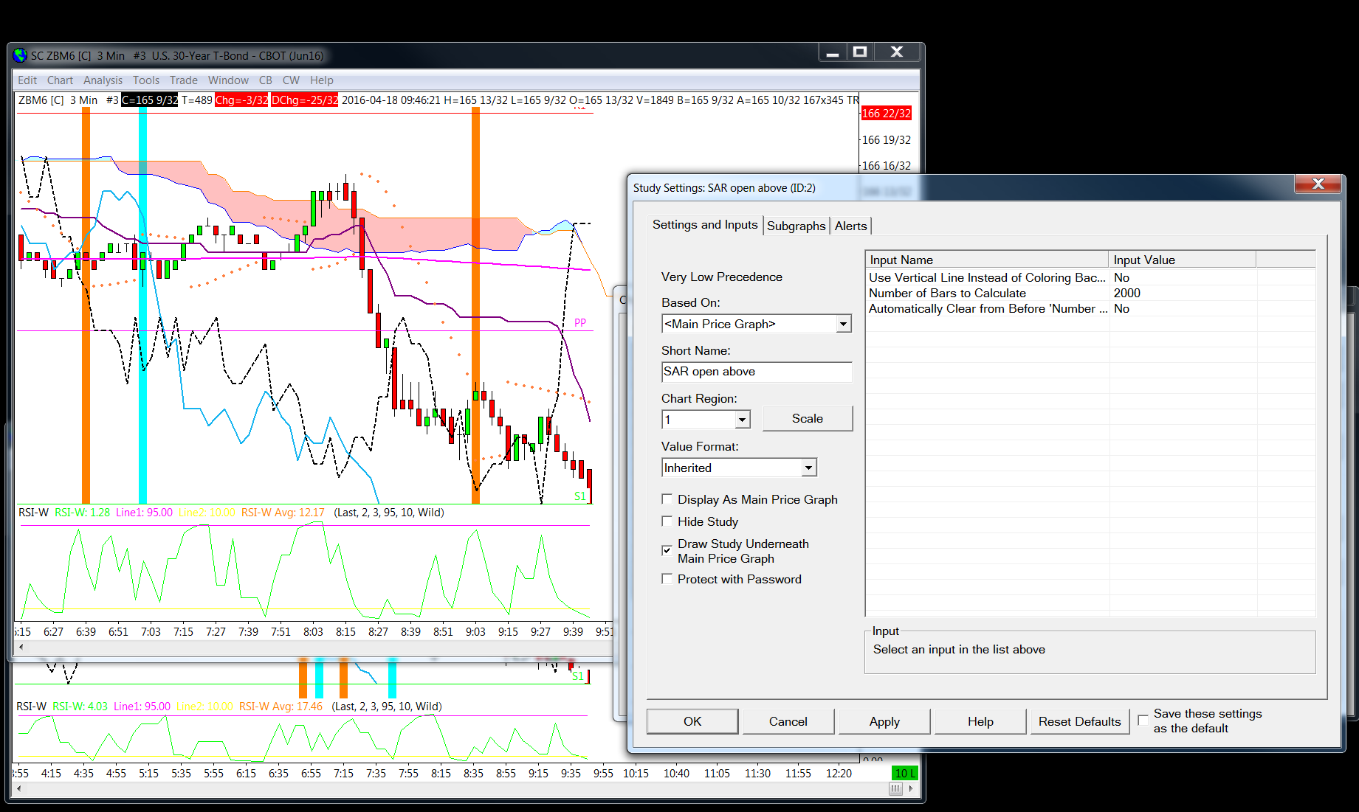
Alert triggered
Alert not triggered

