Slide 1
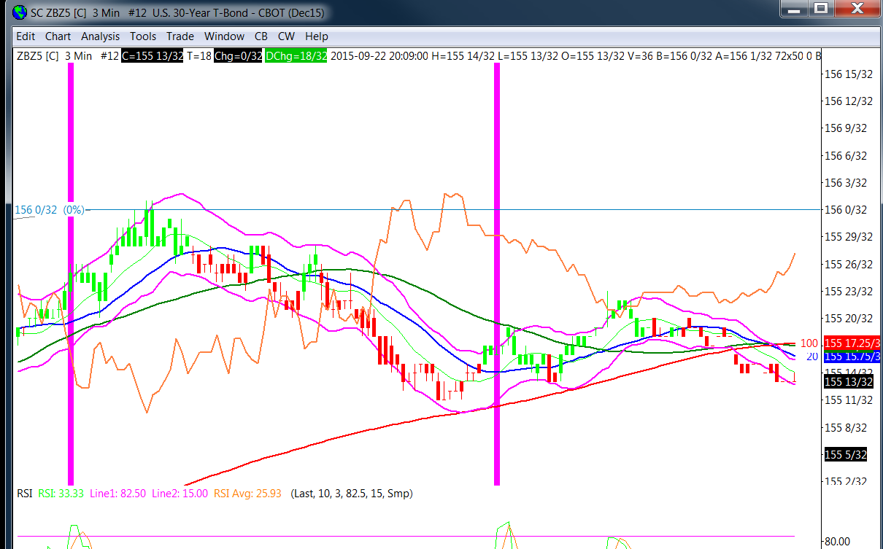
Notes:
Chart facts:
Base chart is the 30 year bond (ZB) price action (PA).
Overlayed with the ES SP emini PA.
Help:
I want an audible alert with when ZB PA and ES PA intersections in the blue circles areas.
Thank you

