Slide 1
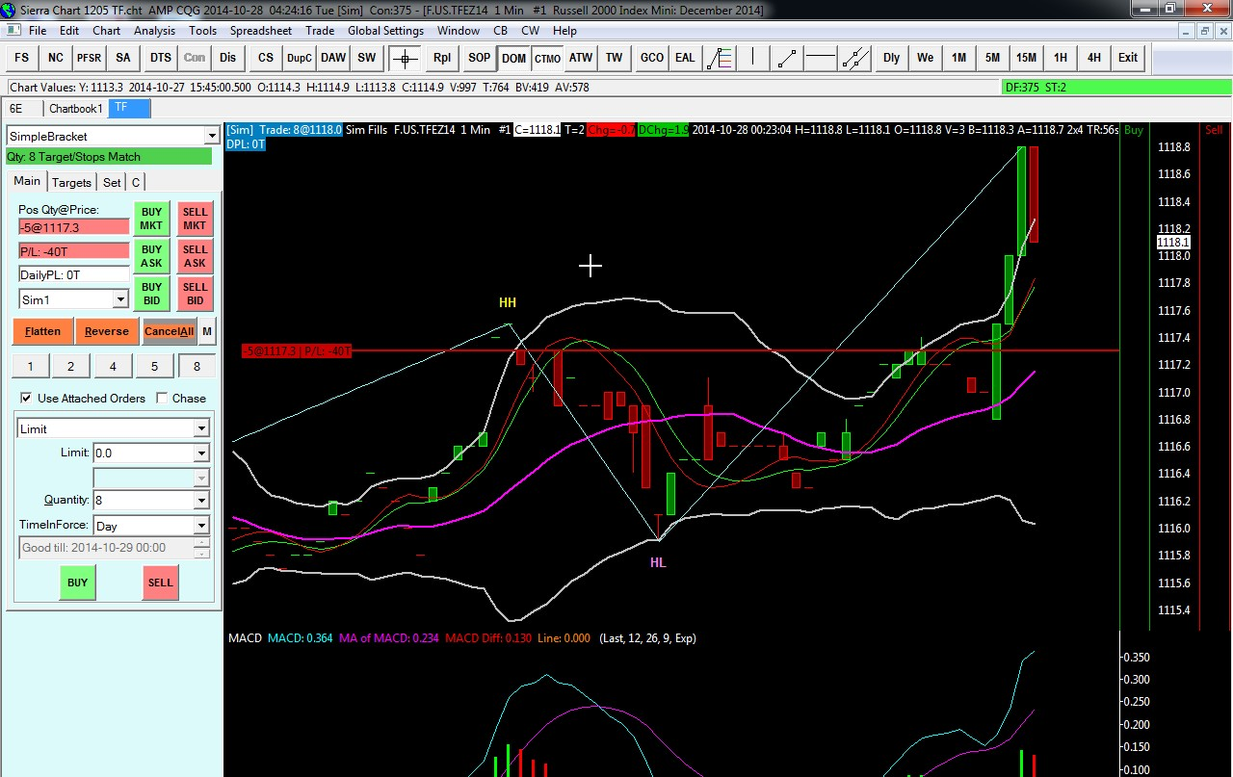
Why P/L shows 40Ticks when actual is only 8T?
1118.1 – 1117.3 = 8T
What setting do I need to change..?
How can I see P/L in actual $$ value.. In this case -400 ?

Slide 2
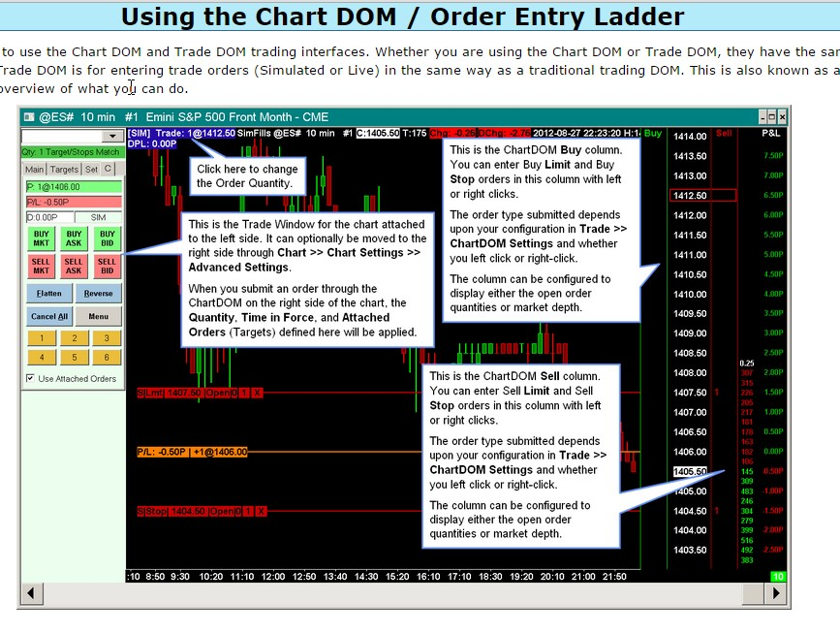
What is the setting to display this on my Chart DOM ?

